Slide 1

7th Grade Math
Unit 13, Lesson 9 Creating Displays for Categorical Data Volume 2, pg. 281

Slide 2


Benchmark
MA.7.DP.1.5
Given a real-world numerical or categorical data set, choose and create an appropriate graphical representation.
volume 2, pg. 281

Slide 3
Integrated Mathematical Thinking and Reasoning Standards
MA.K12.MTR.1.1 Actively participate in effortful learning both individually and collectively.
MA.K12.MTR.2.1 Demonstrate understanding by representing problems in multiple ways.
MA.K12.MTR.7.1 Apply mathematics to real-world contexts.
volume 2, pg. 281

Slide 4

Learning Target
I can create an appropriate graphical representation for a categorical data set.
volume 2, pg. 281

Slide 5

Warm-Up
volume 2, pg. 282

Slide 6

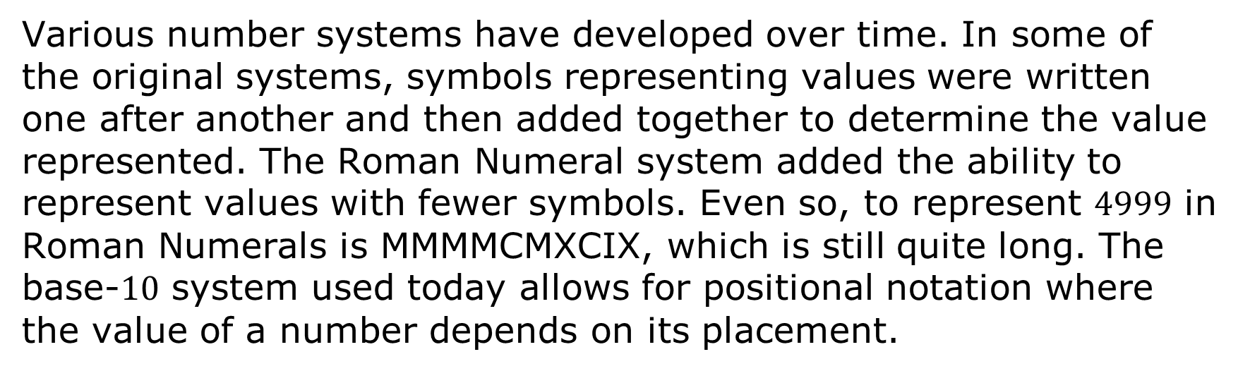
13.9.1 Warm-Up: Visual Representations
Various number systems have developed over time. In some of the original systems, symbols representing values were written one after another and then added together to determine the value represented. The Roman Numeral system added the ability to represent values with fewer symbols. Even so, to represent $4999$ in Roman Numerals is MMMMCMXCIX, which is still quite long. The base-$10$ system used today allows for positional notation where the value of a number depends on its placement.
volume 2, pg. 282

Slide 7
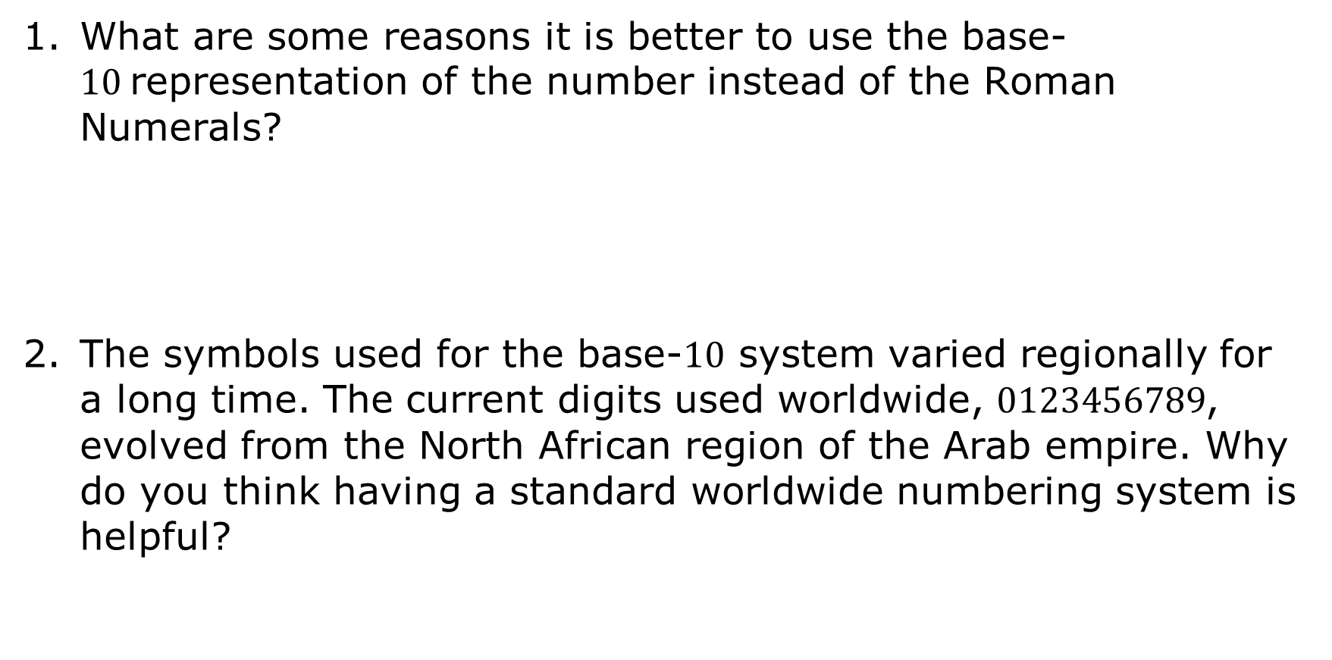
What are some reasons it is better to use the base-$10$representation of the number instead of the Roman Numerals?
The symbols used for the base-$10$ system varied regionally for a long time. The current digits used worldwide, $0123456789$, evolved from the North African region of the Arab empire. Why do you think having a standard worldwide numbering system is helpful?
volume 2, pg. 282

Slide 8

Guided Instruction
volume 2, pg. 282

Slide 9
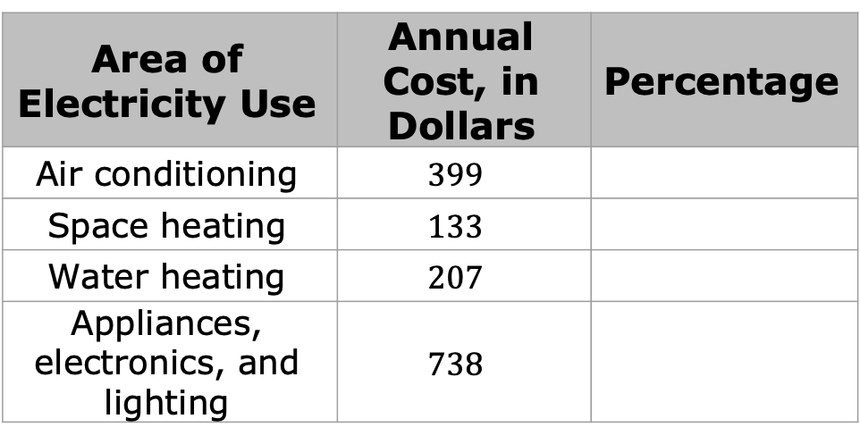
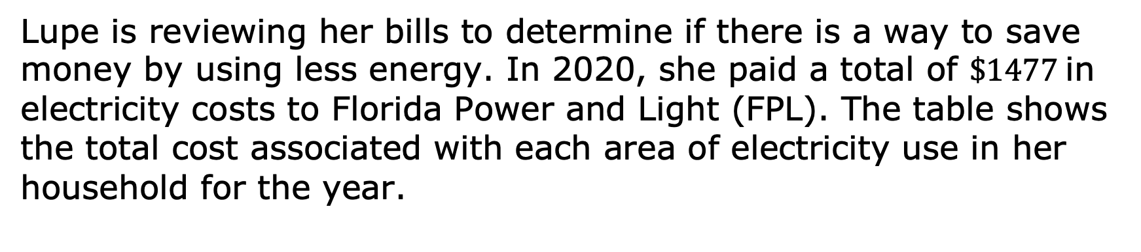
13.9.2 Guided Instruction: Graphical Representations for Categorical Data
Lupe is reviewing her bills to determine if there is a way to save money by using less energy. In 2020, she paid a total of $\$1477$in electricity costs to Florida Power and Light (FPL). The table shows the total cost associated with each area of electricity use in her household for the year.
Area of Electricity Use | Annual Cost, in Dollars | Percentage
Air conditioning | $$399$$
Space heating | $$133$$
Water heating | $$207$$
Appliances, electronics, and lighting | $$738$$
volume 2, pg. 282

Slide 10
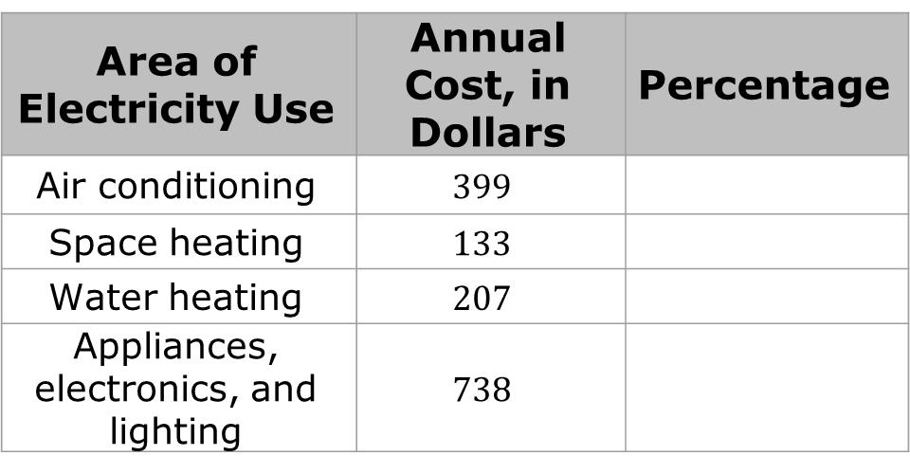
Area of Electricity Use | Annual Cost, in Dollars | Percentage
Air conditioning | $$399$$
Space heating | $$133$$
Water heating | $$207$$
Appliances, electronics, and lighting | $$738$$
Use the data to create a bar graph for Lupe’s data set.
Complete the table by calculating the percentage of Lupe’s electricity costs for each area of electricity use.
volume 2, pg. 282 & 283

Slide 11
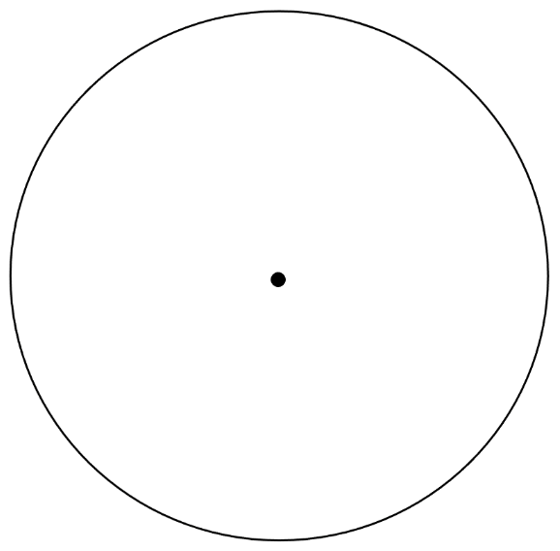
Create a circle graph for Lupe’s data set.
Discuss with your partner how each data display can be useful to Lupe as she considers ways to reduce her energy bills.
volume 2, pg. 283

Slide 12
Complete the statements.
The bar graph displays the
Lupe pays for each area of electricity use, while
the circle graph displays the
Lupe pays for each.
Lupe can use the to analyze whether
there are any areas of electricity use that make up too
large of a portion of her bill to determine where she
should try to reduce her electricity consumption.
actual amount
proportion of the total cost
actual amount
proportion of the total cost
bar graph
circle graph
volume 2, pg. 283

Slide 13
bar graph
circle graph
She can use the to show her
family the actual cost of each area of use as they
set goals for using less energy, such as taking
shorter showers or running the air conditioner at
a higher temperature.
volume 2, pg. 283

Slide 14

Bar graphs and circle graphs are both useful for visually representing categorical data.
The purpose of displaying the data can also be used to determine which graph is best.
Bar graphs are best when the goal is to compare categories to each other or to compare the actual values. They visually show how each part compares to other parts and display the exact counts or values for each category.
Circle graphs are best when the goal is to compare parts to a whole. They visually show each category as a proportion related to the whole.
volume 2, pg. 283

Slide 15

Try It
volume 2, pg. 284

Slide 16


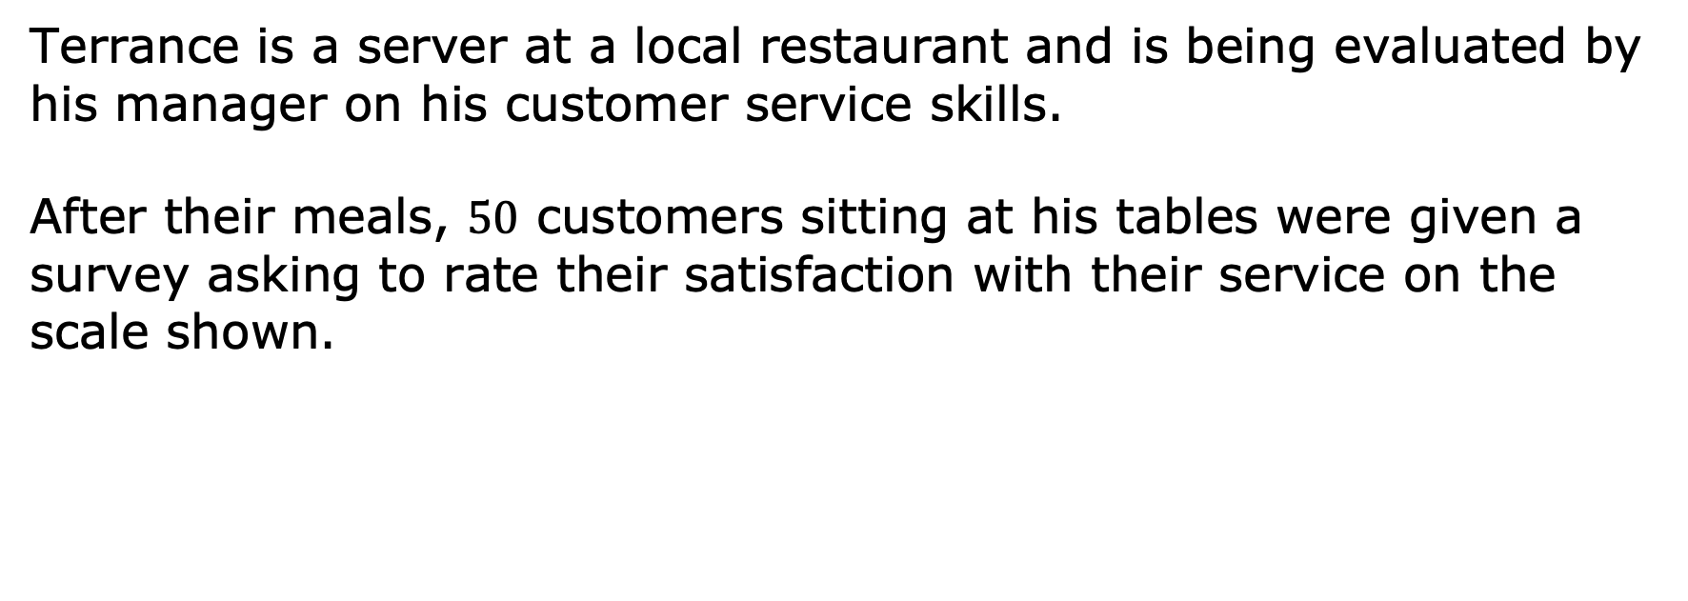
13.9.3 Try It: Graphical Representations for Categorical Data
Terrance is a server at a local restaurant and is being evaluated by his manager on his customer service skills.
After their meals, $50$ customers sitting at his tables were given a survey asking to rate their satisfaction with their service on the scale shown.
volume 2, pg. 284

Slide 17





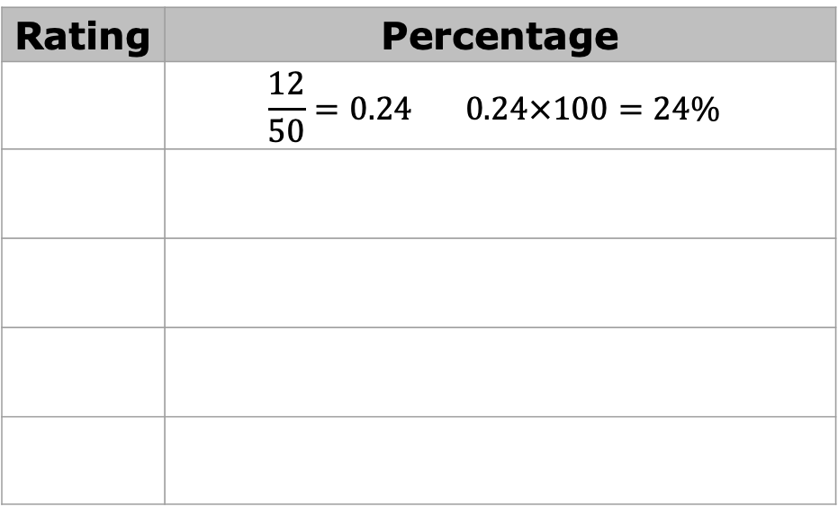
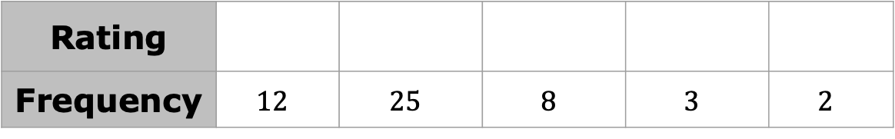
The results are shown in the frequency table.
Complete the table to determine the percentage of customers who responded with each rating. The first row has been completed for you.
Rating
Frequency | $$12$$ | $$25$$ | $$8$$ | $$3$$ | $$2$$
Rating | Percentage
 | $$\frac{12}{50}=0.24 0.24×100=24\%$$
volume 2, pg. 284

Slide 18
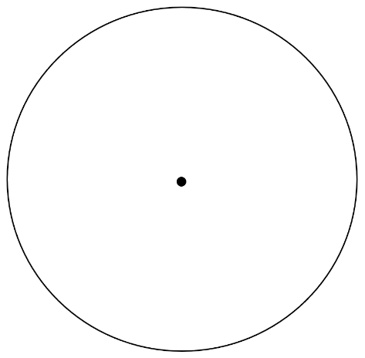
Use your calculated percentages to create a circle graph displaying Terrance’s survey data.
With your partner, discuss some conclusions that can be drawn about Terrance’s customer service based on the circle graph. Then, write three statements summarizing the conclusions discussed.
volume 2, pg. 284

Slide 19
Complete the statement.
The best graphical representation for Terrance’s
data is a because it helps us
visualize how each rating category compares to
the whole.
If Terrance’s manager wants to compare two servers’ customer service skills, explain whether it would be better to create two circle graphs or two bar graphs.
bar graph
circle graph
volume 2, pg. 285

Slide 20
Compare your recommendation with your partner’s. Discuss any differences in your reasoning.
Complete the statements.
If the same number of customers responded to
each server’s survey, a is a better
choice for comparing these two data sets
because the in each server’s
graph can be easily compared side-by-side.
bar graph
circle graph
height of the bars
size of each section
volume 2, pg. 285

Slide 21
If a different number of customers responded
to each server’s survey, a would
be better because it would compare the who gave each
response rather than the raw numbers that
could be misleading in this case.
bar graph
circle graph
actual number of customers
proportion of customers
volume 2, pg. 285

Slide 22

Wrap-Up
volume 2, pg. 286

Slide 23
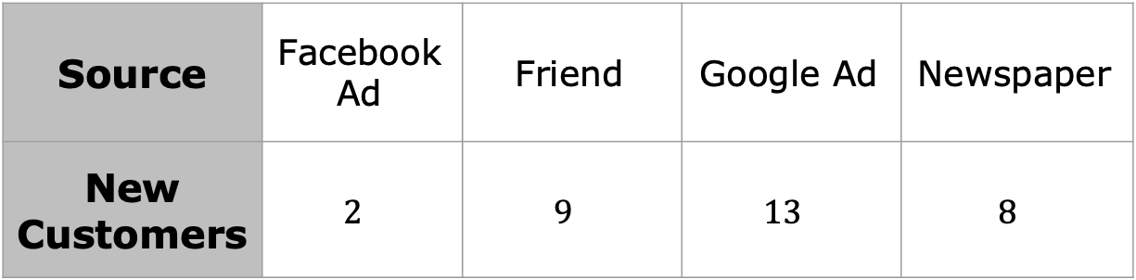
13.9.4 Wrap-Up: Ticket Out the Door
The manager at a new restaurant surveys a sample of customers to identify where their marketing efforts have been successful. The results are shown in the frequency table.
Source | Facebook Ad | Friend | Google Ad | Newspaper
New Customers | $$2$$ | $$9$$ | $$13$$ | $$8$$
volume 2, pg. 286

Slide 24
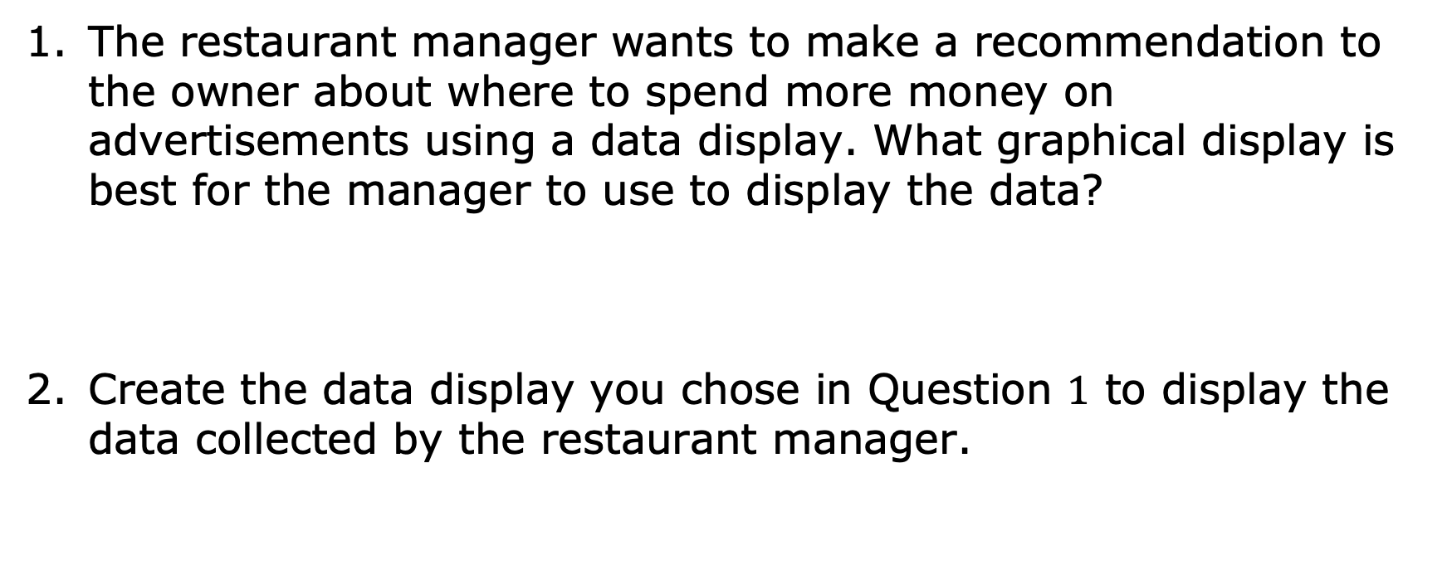
The restaurant manager wants to make a recommendation to the owner about where to spend more money on advertisements using a data display. What graphical display is best for the manager to use to display the data?
Create the data display you chose in Question $1$ to display the data collected by the restaurant manager.
volume 2, pg. 286

